Slide 1

Coding in the Cloud
Getting Started with GitHub Codespaces

Slide 2
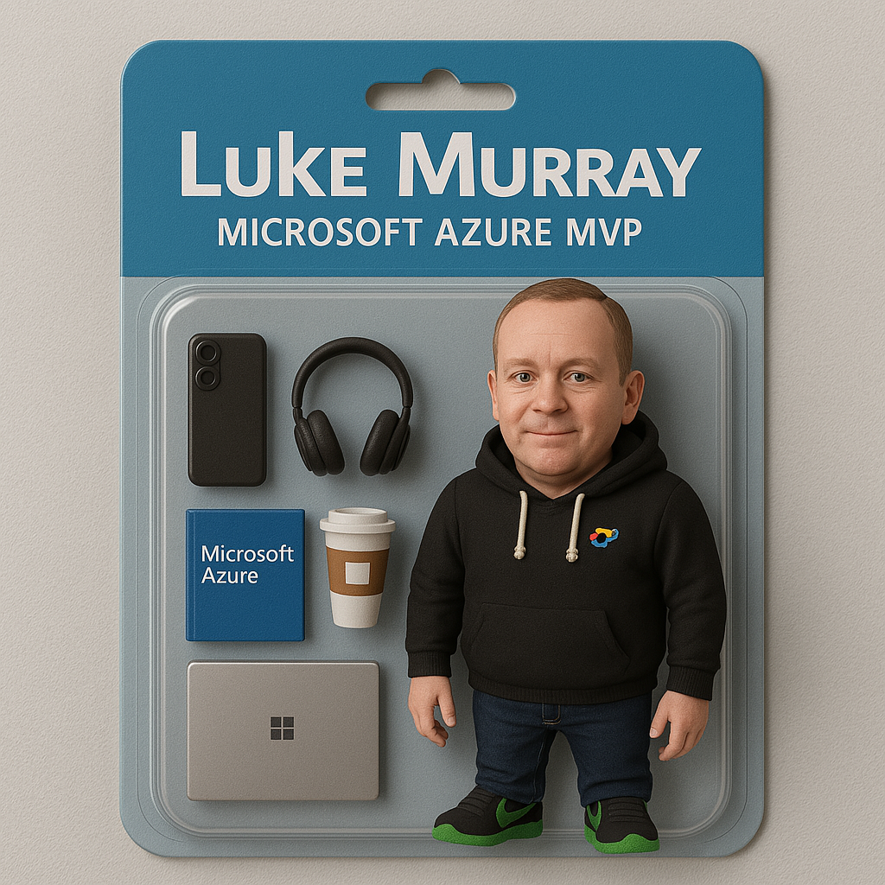



Hello!
Thank you for joining us today
Speaker: Luke Murray
Microsoft Learn Expert and Microsoft Azure MVP, and ISM Service Lead, at HSO from Hamilton, New Zealand.
https://x.com/lukemurraynz
https://www.linkedin.com/in/ljmurray/
https://luke.geek.nz/
https://www.youtube.com/@lukemurraynz

Slide 3
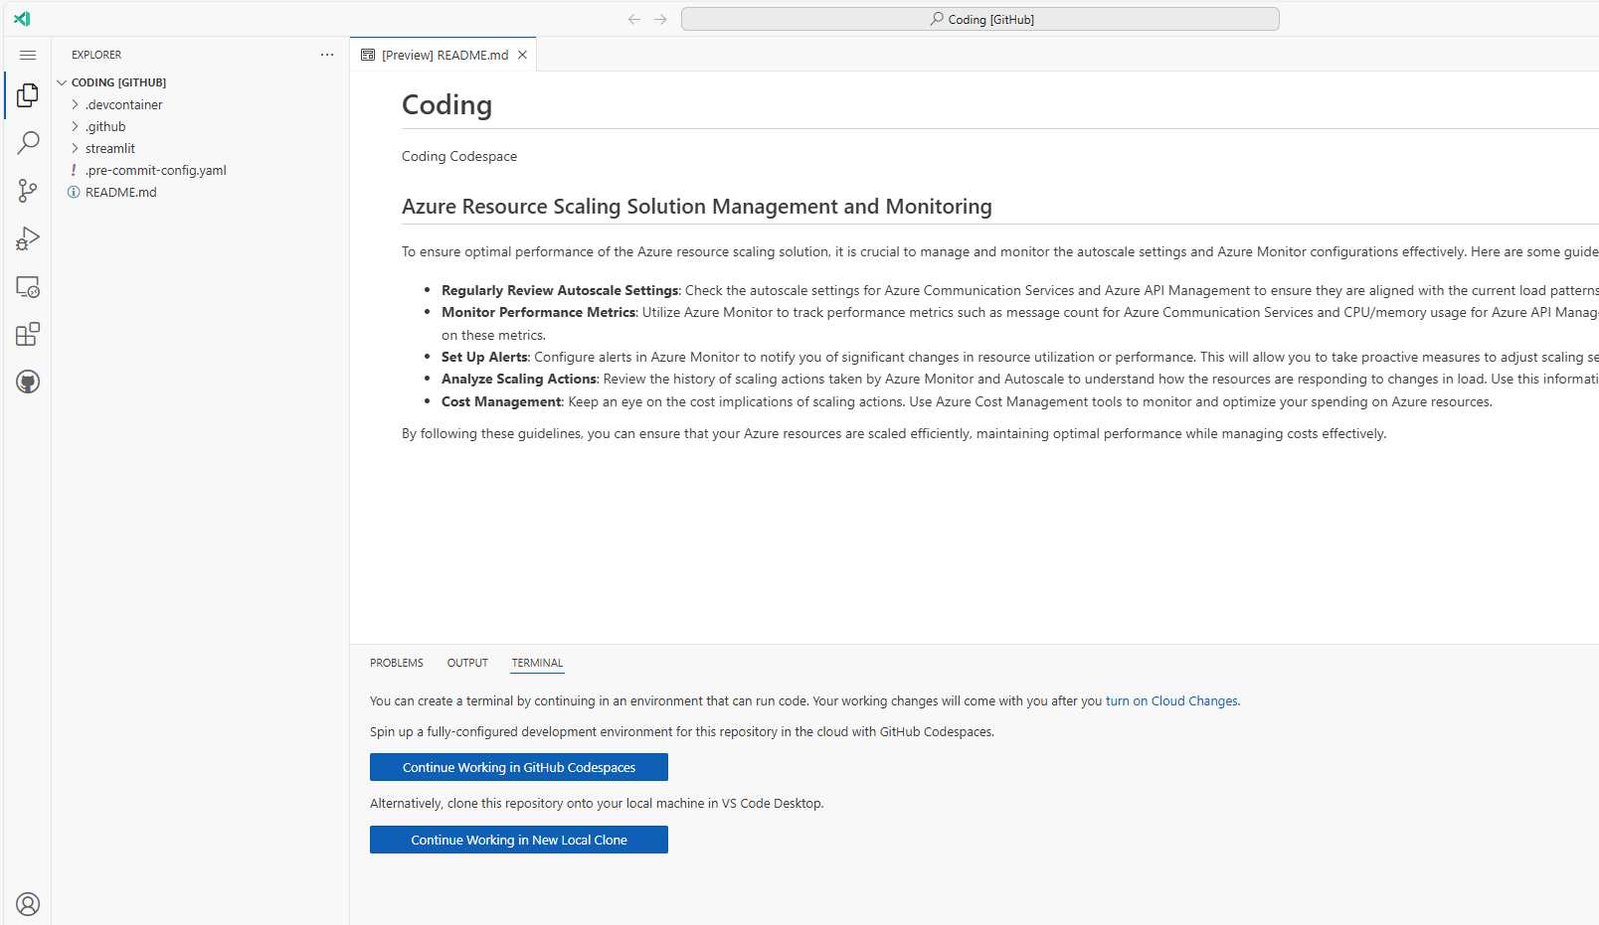
TIP
If you just need a Text Editor in GitHub press . to open VS Code for the Web.

Slide 4
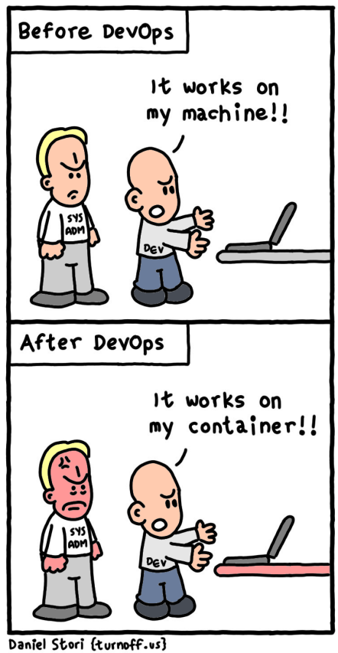
“We lost a whole day getting a QA engineer running on that project.”
“It works on my laptop. Why doesn’t it work on yours?”
“Can I have a 16-core machine?”
“I have no idea what I’ve installed over the years?”

Slide 5
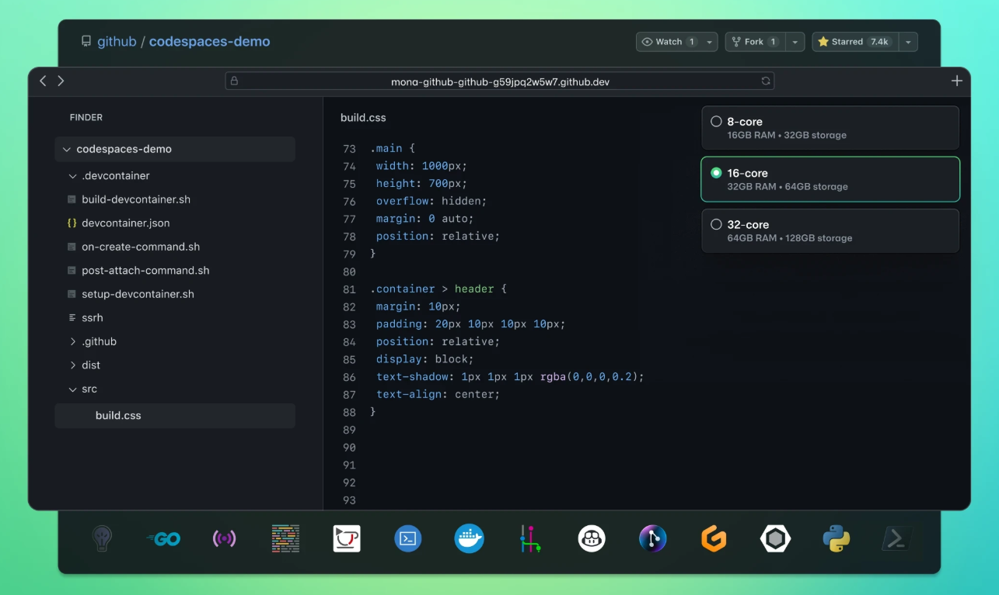
What is a GitHub Codespace?
“A hackathon (also known as a hack day, hackfest, datathon or codefest; a portmanteau of hacking and marathon) is an event where people engage in rapid and collaborative engineering over a relatively short period of time such as 24 or 48 hours. They are often run using agile software development practices, such as sprint-like design wherein computer programmers and others involved in software development, including graphic designers, interface designers, product managers, project managers, domain experts, and others collaborate intensively on engineering projects, such as software engineering.”
~ Wikipedia

Slide 6
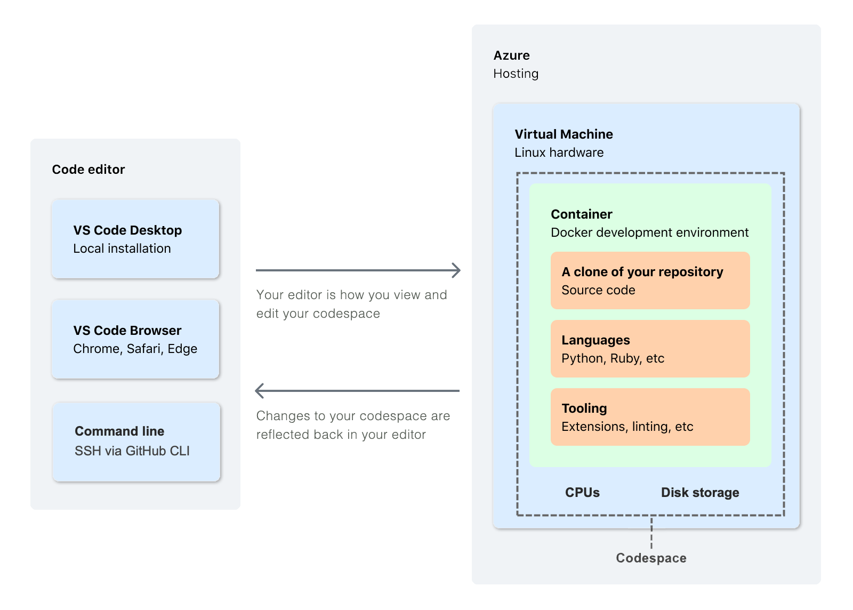

Slide 7


Managed environments for any project
Fully-managed, on-demand dev environments that dramatically reduce setup and maintenance
Feel at home even when away
Environment can be configured, and your settings, themes, and Git identity, are roamed so the experience looks and feels like local
Develop from anywhere
Environment can be configured, and your settings, themes, and Git identity, are roamed so the experience looks and feels like local
Supercharged collaborative development
Fully collaborative environment, complete with AI-assisted development support

Slide 8
Codespace vs Devcontainer
https://containers.dev/
Feature | Devcontainer | Codespace
What it is | Configuration for a Docker-based dev environment | Cloud-hosted development environment by GitHub
Defined by | .devcontainer/devcontainer.jsonin your repository | Created via GitHub UI, CLI, or VS Code
Purpose | Specify tools, OS, and settings for dev environment | Provide instant, remote dev environments
Where it runs | Locally (with Docker) or in the cloud | In the cloud (GitHub-managed VMs/containers)
Dependency | Can be used independently | Uses devcontainer config for environment setup
Access | Local VS Code, Docker, or compatible tools | Browser, VS Code, or GitHub CLI

Slide 9
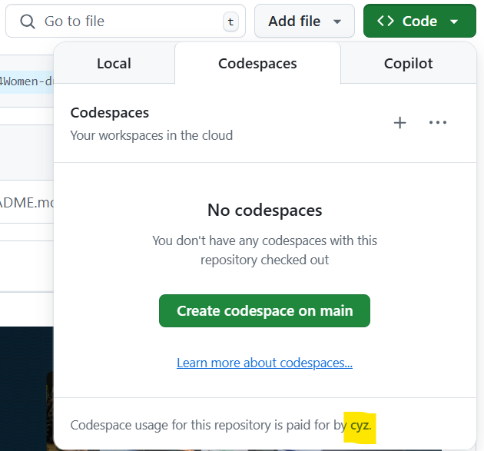
All personal GitHub accounts have a monthly quota of free use of GitHub Codespaces.
The free plan offers 120 hours of usage for
1 core or 60 hours for 2 cores, plus 15 GB of storage per month.

Slide 10

Codespace
DEMO

Slide 11
Q&A

Slide 12
Thank you

